Slide 1

WORLD CUP FANDOM IN BANGLADESH

Slide 2

TEAM CRYSTAL
● Fahamidul Jahan Sajid
232-16-030
● Rafiat Khan Mishal
232-16-008
Department Of CIS
Course Teacher: Sumaiya Tani
● Jannatul Ferdous
232-16-029
● Kafi Mahmud Sajid
232-16-033
● Farhan Tanvir Dipto
232-16-040

Slide 3
Bangladesh’s World cup Fandom: Passionate Fanbase
History of Bangladeshi Fandom
The Bangladesh national cricket team was formed in 1976. The country gained Test status in 2000, which was a significant milestone for cricket in Bangladesh. The first football club in Bangladesh, Dhaka Mohammedan Sporting Club, was established in 1933. world cup fandom in Bangladesh is characterized by passionate supporters who celebrate victories and support their team through ups and downs.
Passionate Fan base of Bangladesh
The World cup fever sweeps through Bangladesh every four years as building rooftops boast fan’s favourite team’s flag and football dominate conversations amongst the masses.
From the capital city of Dhaka to the port city of Chittagong, from the megacities to the most remote areas, wherever you go, you would see such excitement covering the whole country at large.

Slide 4
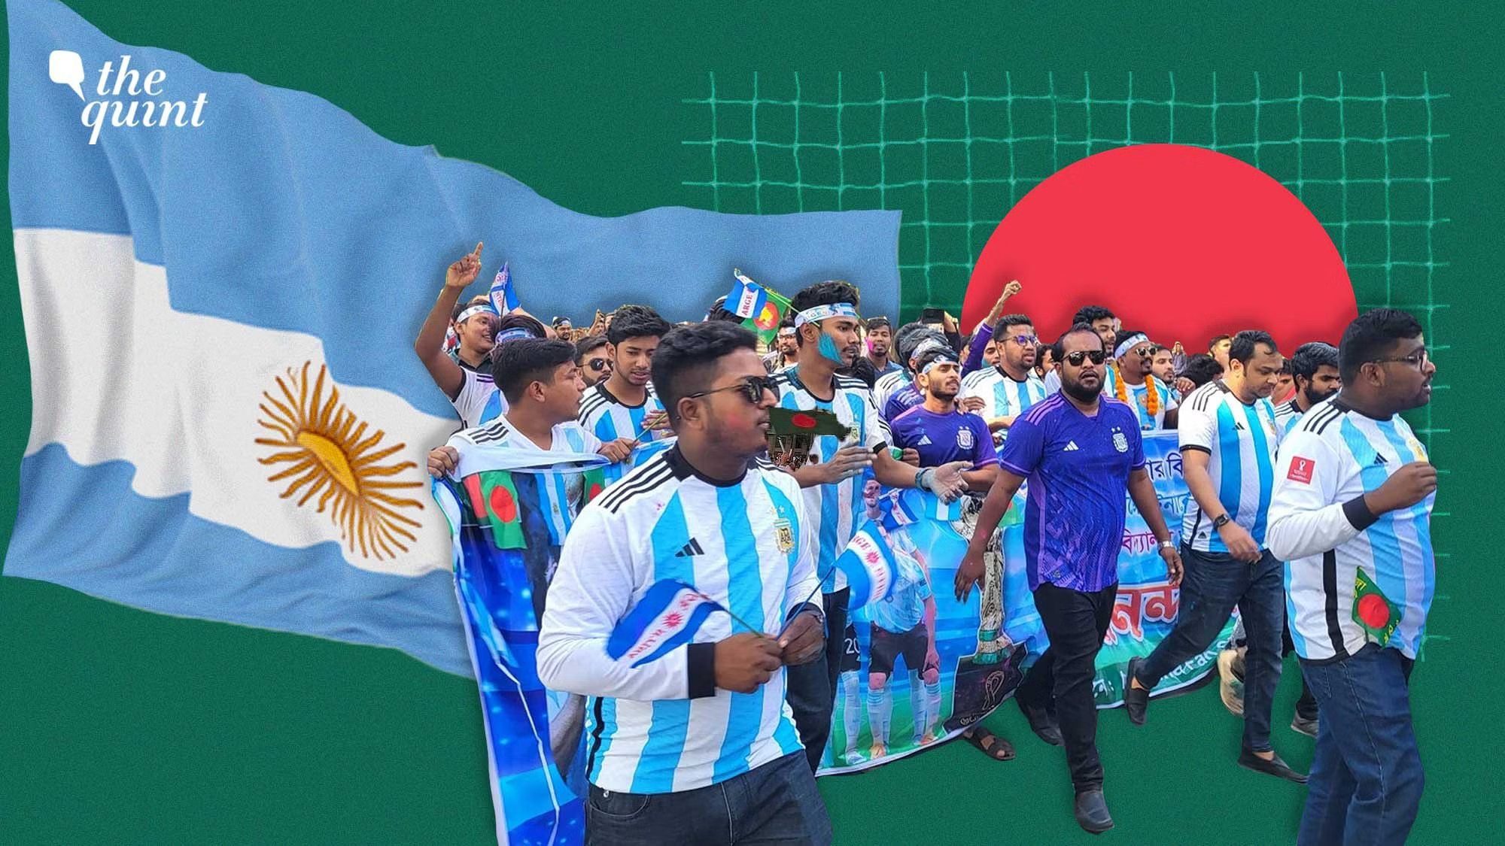
The long South Korea flag from Brahmanbaria: Abdul Kauser Mintu who belongs to Brahmmanbaria has a story of enthusiasm for football. Mintu and his wife sought to pray tribute by doing something special for South Korea. They sell their land to get an amount Tk 3.20 lakh to complete the enormous flag. It runs in the blood: The passion for the game has been part of the tradition for a long time but it is only during the World Cup when fans find the right occasion to show their true colors. “

Slide 5
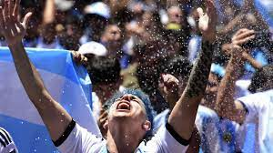
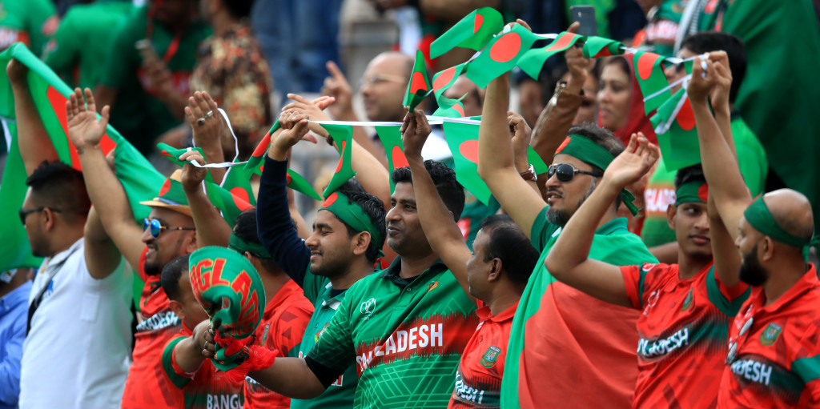
The Significant world cup impact on our daily life
The World Cup, whether in football or cricket, transcends the realm of sports to become a global cultural phenomenon. The impact of the world cup on our daily life is significant and diverse:
1.Emotinal Engagement
The World Cup elicits strong emotions.

Slide 6
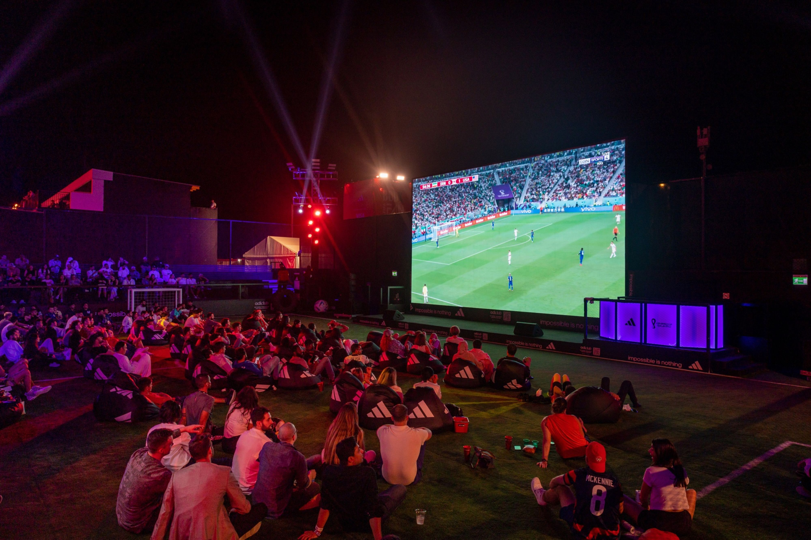
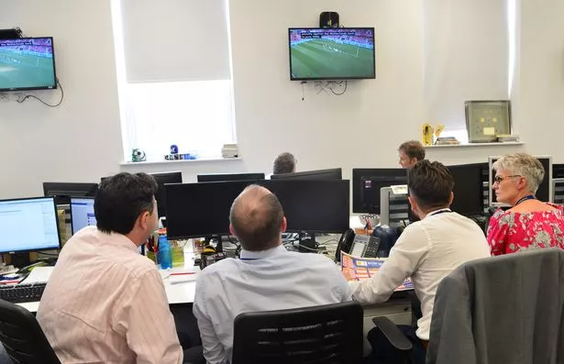
2.Social Gatherings The World Cup brings people together. 3.Workplace Dynamics Matches occurring during working time.

Slide 7
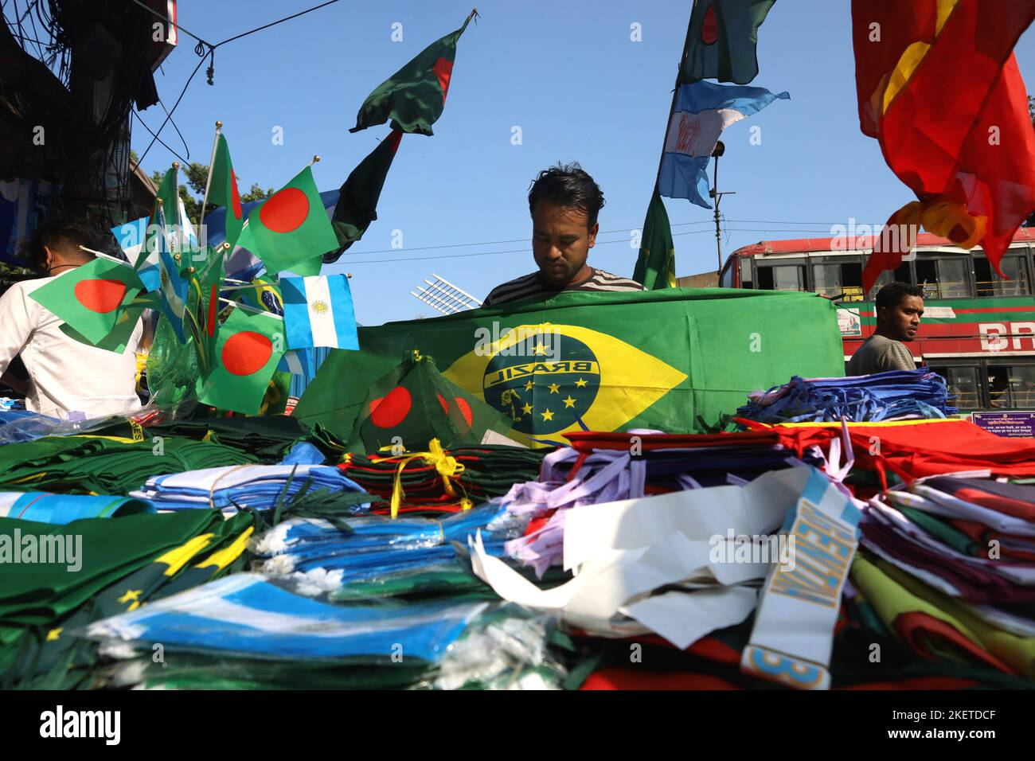
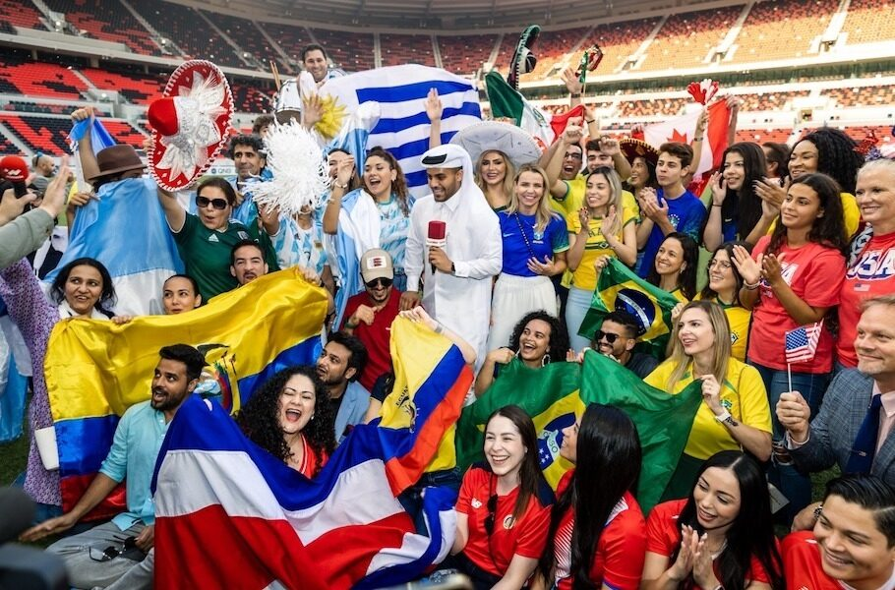
4.Economic Impact
The world Cup boosts consumer spending.
5.Global Connection
The tournament connects people across borders.

Slide 8
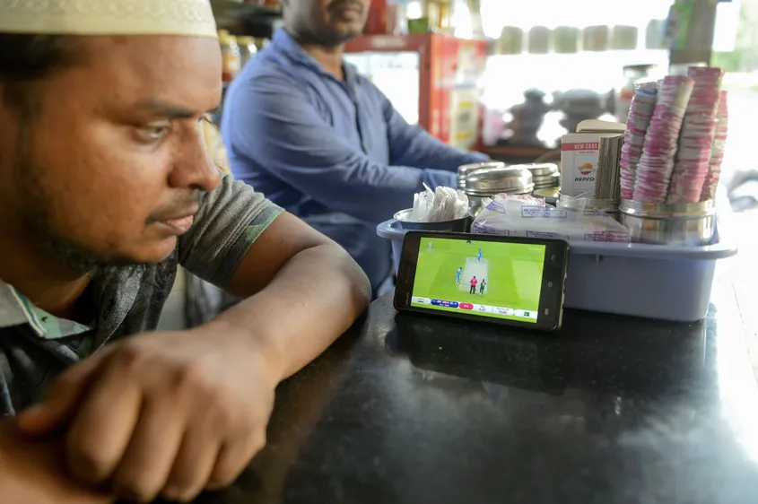
Social media and digital fandom
Fandom is more than just a hobby or interest, it's a way of life. During the World Cup, fans from all over the world come together to celebrate their love for the game and their favorite teams. The passion and dedication of these fans is truly remarkable, and it's what makes the World Cup such a special event.
Workshop # 1
Workshop # 2

Slide 9
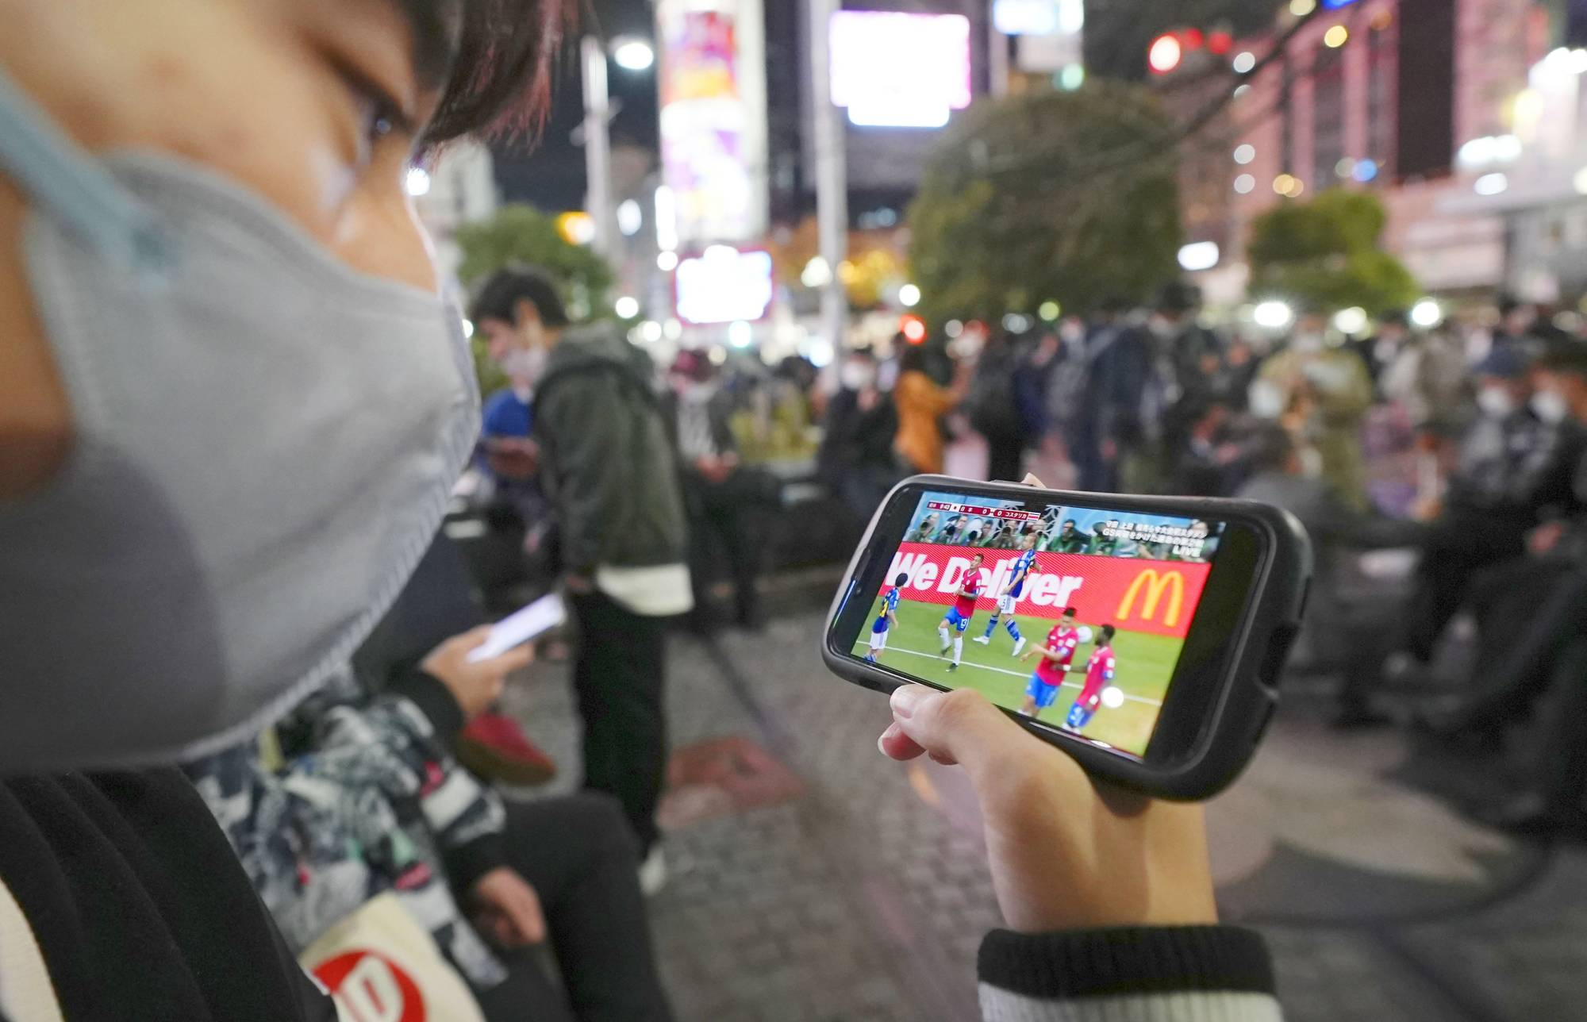
Digital fandom
Digital fandom is a term used to describe the online communities formed around a shared passion for a particular topic, such as sports or entertainment
Role of Social media
Social media has revolutionized the way we consume and engage with sports content. With over 3.5 billion active social media users worldwide, it's no surprise that sports organizations have flocked to these platforms to connect with fans.
How Social Media is Causing a Negative Impact on world cup for the fans!
Social media has become a breeding ground for harmful behavior during the World Cup. The spread of fake news, cyberbullying, and other negative behaviors can have a significant impact on the tournament and its fans

Slide 10
Hope and unity
Hope and unity Bangladesh World Cup Fandom:
HOPE:
A belief in positive outcomes
Emotional and psychological well-being
Motivation for action
An essential human emotion
UNITY:
Explanation of unity as working together harmoniously
The concept of individuals or groups coming together for a common purpose
Unity as a source of strength and resilience

Slide 11

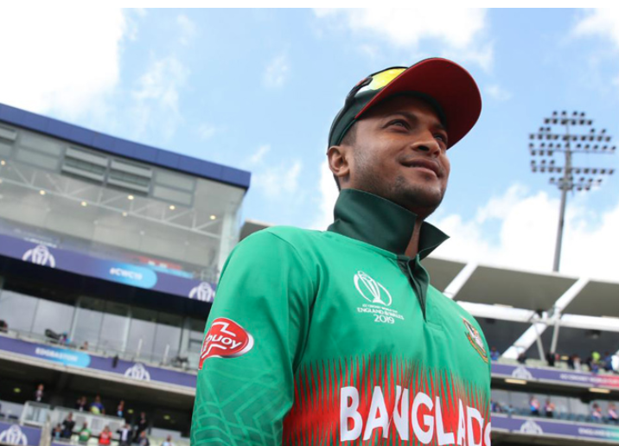
The Power Of Hope And Unity
HOPE OF FANDOM
“The hope for Lionel Messi to lift the World Cup” trophy is a shared dream in the hearts of countless football fans worldwide. For years, fans have passionately cheered for Messi's brilliance on the field, hoping to witness his talent crowned with the ultimate prize.
This hope transcends borders and club allegiances, uniting fans in their collective aspiration to see one of the greatest footballers of all time achieve World Cup glory. And the world greatest player got the worldcup trophy.In the same way in Bangladeshi cricket fandom wants Shakib Al Hasan achieve worldcup glory for Bangladesh.

Slide 12
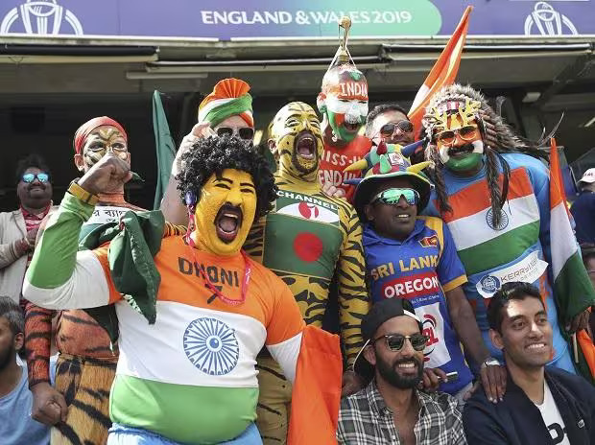
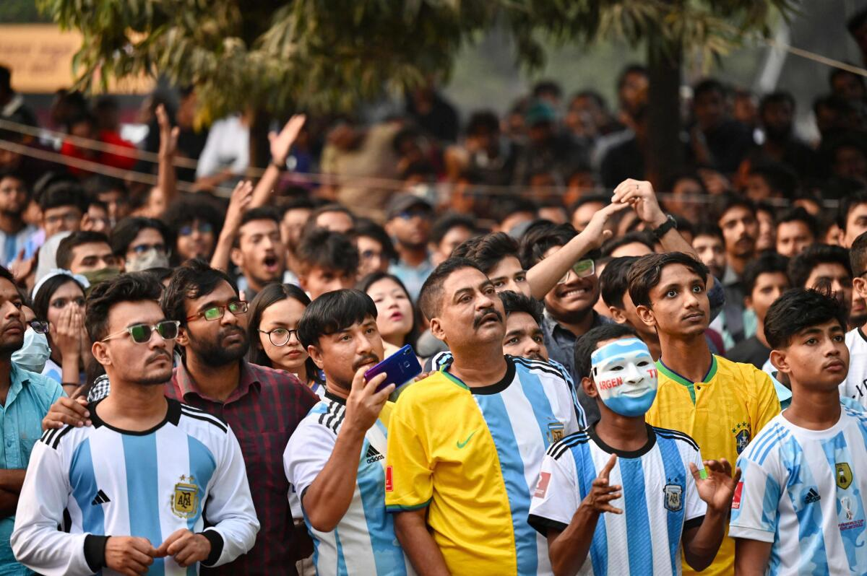
UNITY OF FANDOM:
World Cup fandom in Bangladesh epitomizes unity as the entire nation unites with unwavering passion.
Regardless of differences in age, background, or beliefs, the World Cup becomes a common thread that binds Bangladeshis together. The World Cup becomes a powerful symbol of solidarity and a testament to the unifying force of sports.

Slide 13
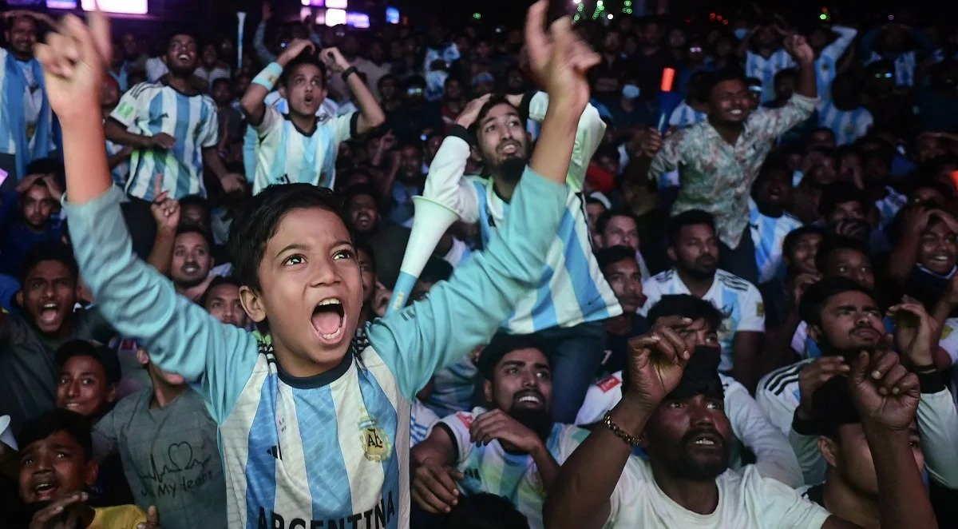
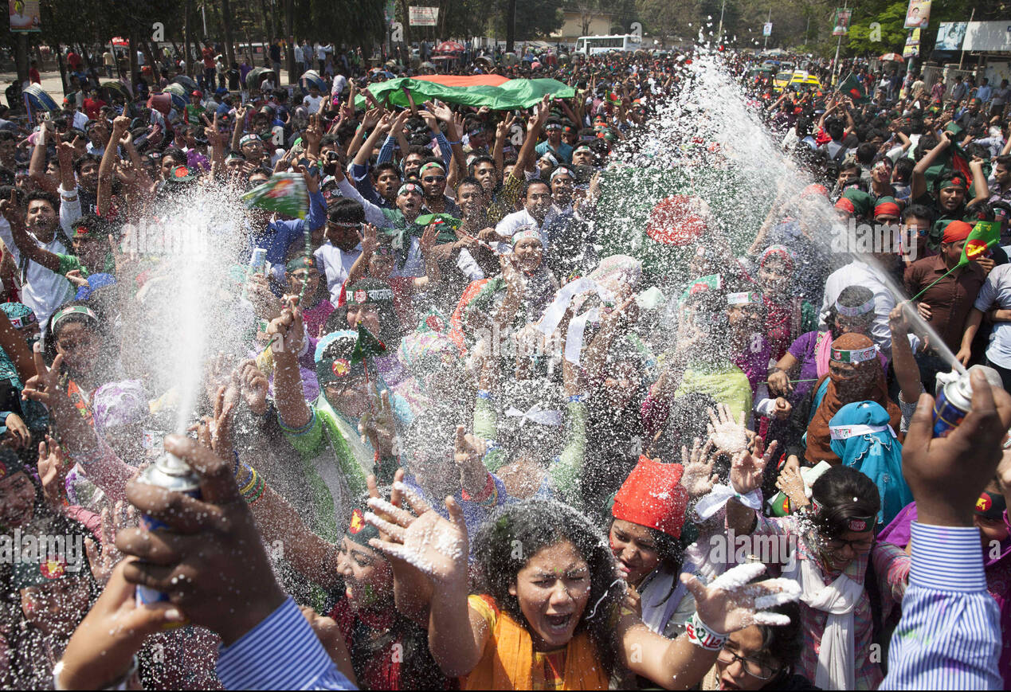
Bangladesh's World Cup Fandom: A Glimpse into the Future
Statistics and anecdotes about Bangladesh's World Cup viewership:
According to recent surveys, over 70% of the population in Bangladesh follows the World Cup, making it one of the most popular sporting events in the country.
>The men's T20 World Cup drew 78.4 million visitors on digital platforms
>Over 25m viewers watched Fifa World Cup Round of 16 on digital platform.

Slide 14
Expanding World Cup Fandom in Bangladesh
To better understand how to involve more demographics in World Cup fandom, we spoke with key figures in the Bangladesh football and cricket community.
To increase World Cup fandom reach, we need to focus on grassroots efforts and involve more young people.
creating opportunities for both men and women and people of different backgrounds to participate and feel welcome in the sport.
Investing in infrastructure and technology to improve the viewing experience for fans, such as upgrading stadiums and offering live streaming options.

Slide 15
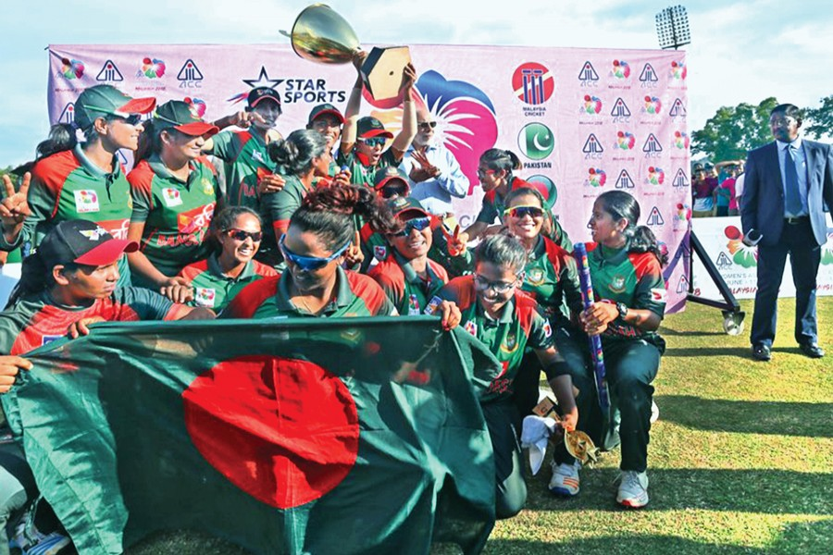

Optimism for World Cup Fandom in Bangladesh:
As social media continues to evolve and become more integrated into our daily lives, it is likely that its impact on World Cup fandom in Bangladesh will only continue to grow. Fans will have even more opportunities to connect and engage with each other, and the use of social media may even lead to the development of new fan communities and traditions. Overall, the future of World Cup fandom in Bangladesh looks bright, and social media will undoubtedly play a crucial role in shaping this experience for fans across the country.

Slide 16
BULLET POINTS OF OUR PRESENTATION:
How fans are passionate about world cup
Impact on our daily life
Social media and digital fandom.
Hope and unity
World cup fandom: a glimpse into the future

Slide 17
Conclusion:
We have explored the fascinating history and personal stories of
world cup fandom in Bangladesh. The tournament has brought
people together, fostered a sense of national pride, and provided
moments of joy for fans across the country.So let us embrace the passion and excitement of World Cup fandom, while also being mindful of the challenges and controversies that exist.

Slide 18
THANK YOU!
ANY QUESTIONS?

